Slide 1
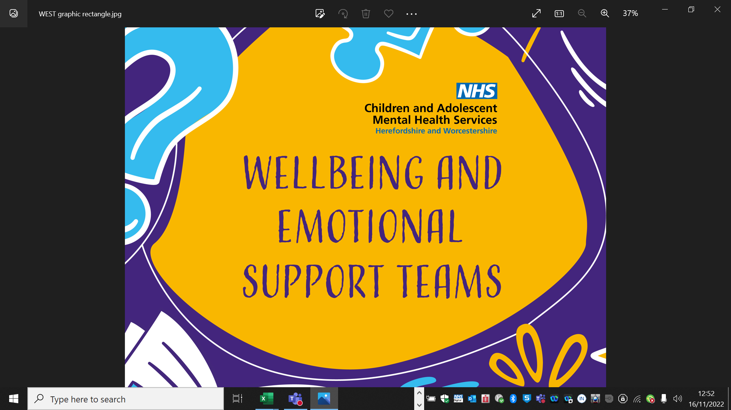
Building Resilience In Your Child
Workshop for Parents and carers of primary school-aged children

Slide 2
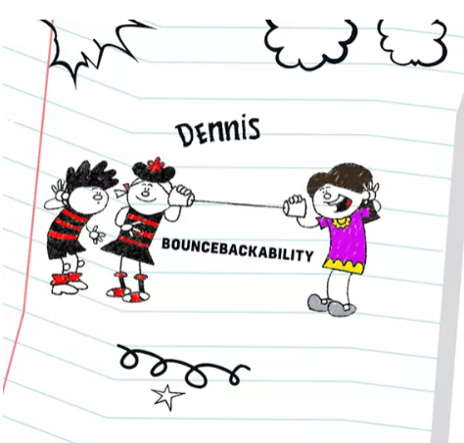
Agenda for this session
What is resilience and why is it important?
What can you do to support your child in
building their resilience?
Who else can help?
Notes:
This sessions is planned to be 45 mins
This is the plan of what we will be covering in today’s session
This presentation is also available on our website if you want to rewatch it at any point.

Slide 3
What does being resilient mean?
Resilience is the ability to withstand adversity and bounce back from difficult life events. Being resilient does not mean a person doesn't experience stress, emotional upheaval, and suffering. Resilience involves the ability to work through emotional pain and suffering.
It is about building positive relationships with others at home, school and in the community and learning skills to manage stress before becoming too overwhelmed
Notes:
What this means for us is:
Being resilient means being more able to manage the inevitable stresses and challenges in life.
It means you have some skills to deal with difficult times and learn from them
Resilient children and young people are more likely to have better mental wellbeing, willing to have a go and able to adapt to changes around them.
It doesn’t mean that children and young people who are resilient are always happy and confident and never need support. None of us are happy all the time and we all need help at points in our lives.

Slide 4
Some of the stressors effecting children
Tests
Transitions to new classes/schools
Change
Friendship problems
Difficulties at home
Bullying
Lack of sleep
Juggling lots of responsibilities /commitments
Conflict
Illness
Notes:
There are many stressors that children and young people face.
Stressors can be the day to day down’s as in the graph. The daily frustrations, disappointments and challenges.
Stressors can also be the bigger things as listed her – some they have control over and some they don’t, some that are short lived and some that go on for a long period of time.

Slide 5
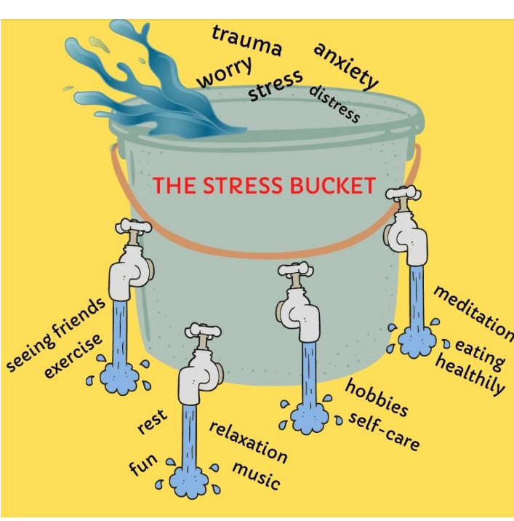
The Stress Bucket
https://youtu.be/I9vYqbWanalogy B1FA
Notes:
We know that too many ‘downs’ or stresses can get too much for us and we need to learn ways to manage these and look after ourself.
The Stress Bucket is a useful analogy for understanding this. This video explains this a bit more.,
If we are the bucket and the water in our bucket is our stress, our bucket will over flow if we have too much water or stress. We need to learn ways to keep the level of water down/release some water. These may be exercise, seeing friends, having hobbies, learning techniques to calm ourselves down etc. which ultimately we are more able to continue living our lives the way we want to and coping with challenges.

Slide 6
Take a moment to think about your own child or children. What stressors could be filling up their bucket right now?
Some examples of stressors
Tests
Transitions to new classes/schools
Change
Friendship problems
Difficulties at home
Bullying
Lack of sleep
Juggling lots of responsibilities /commitments
Conflict
Illness
Notes:
Ask the group to think about their own child/children – what stresses might be in their bucket now.
Depending on the size of group, you may wish to make this interactive.

Slide 7
What can children and young people do to help empty their bucket?
Notes:
Now we are going to spend some time thinking about what you can do to support your child with to help them build their resilience and empty their bucket.

Slide 8
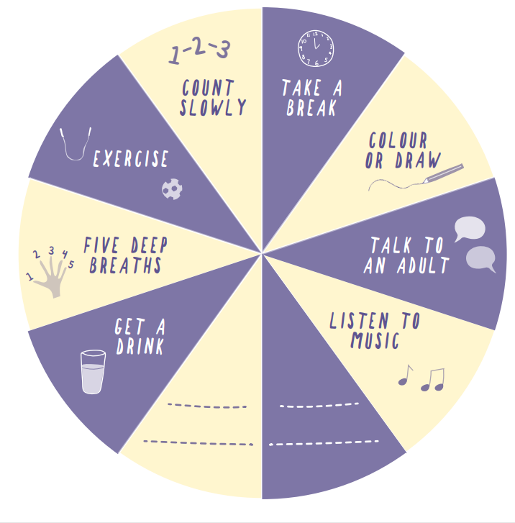
Coping strategies
Helpful
Listen to music
Talk to someone
Go for a walk
Get an early night
Write it down
Take some deep breaths
Think about my options
Meet a friend
Less helpful
Staying in your room at home
Worrying
Refuse to do what your asked
Go off school sick
Blame someone else
Quit
Avoiding people/places/situations
Notes:
Before we start, just a little point on coping strategies we all may use to help manage stress in life.
Some can be helpful and some are unhelpful.
Sometimes the unhelpful ones feel like they are useful to start with, like having days off school for example to avoid certain lessons/teachers/events etc.
But this can easily become a problem in itself if the child/young person then finds it very difficult to go to school again.
I’m sure there have been times in all of our lives where we have avoided something that felt hard but then the longer we avoider it the harder and harder it becomes to face again,.
Today, we are going to think about the helpful strategies to build resilience and manage stress, and what you can do to support your child.
If the unhelpful strategies become too problematic, that is when you may need to ask for further help, we will talk about this a bit more at the end.

Slide 9
Also, letting them have a go, experience some anxiety and learn how to manage this, is really important. But hard for us as parents.
As parents, we naturally want to protect our children from worry and making mistakes.
But actually children need to experience some anxiety and difficult feelings to learn how to deal with it in the future.
It’s also important to guide them in making some decisions and some of their decisions may not be what we would choose, but learning from (small) mistakes is important for young people.
Notes:
We also wanted to acknowledge that seeing our children worried can also cause us a lot of anxiety too.
We need to try and encourage them to have a go at things, not avoid difficult conversations, school days or people. This will help them to see that things often aren’t as bad as they anticipated they would be and even if they are, that feeling of anxiety doesn’t last forever and does reduce.
Similarly with making their own decisions. Supporting your child with small decisions helps them to learn about weighing up the pros and cons of things and problem solving different options.

Slide 10
How our worries and actions can impact our child
Sarah’s Thoughts
Mum’s worried about me, it must be bad
Mum’s Thoughts
Sarah is worried about school.
She won’t cope very well
I must sort this out so she doesn’t worry
Sarah’s Physical Feelings
heart racing, tummy ache
Sarah’s Feelings
Worried
Feelings
Anxious
Behaviour
Let her stay off school
Make decisions for her
Sarah’s Behaviour
Stay with mum
Avoid joining in
Notes:
This diagram helps to explain how sometimes, often without meaning to, the way we respond to things can be picked up by our children. This is great if this is positive but if we are worried about them, the child could perceive there is something to be worried about too.

Slide 11
Managing difficult emotions can be really hard
We all experience a full range of emotions like happiness, sadness, worry, excited and anger and this is normal
We are never going to be happy all the time and that’s fine
But difficult feelings like sadness, anxiety, anger feel horrible and can be hard to regulate
And as a parent it can be really hard to know what to do to help our child when they are struggling with difficult emotions
Notes:
It’s hard but it’s ok to have difficult emotions. It’s normal, we all them, we’re not always happy and that’s fine.
But often we are programmed to think we should be happy all the time.

Slide 12
Helping your child to recognise their emotions
Notes:
Recognising emotions is a good place to start.
This sometimes seems obvious and we can fall into the trap of thinking that young people already understand different emotions and know how to deal with it.
But sometimes young people need more help with this.
The videos clip explains why we feel labelling emotions is important for building resilience in children and young people

Slide 13
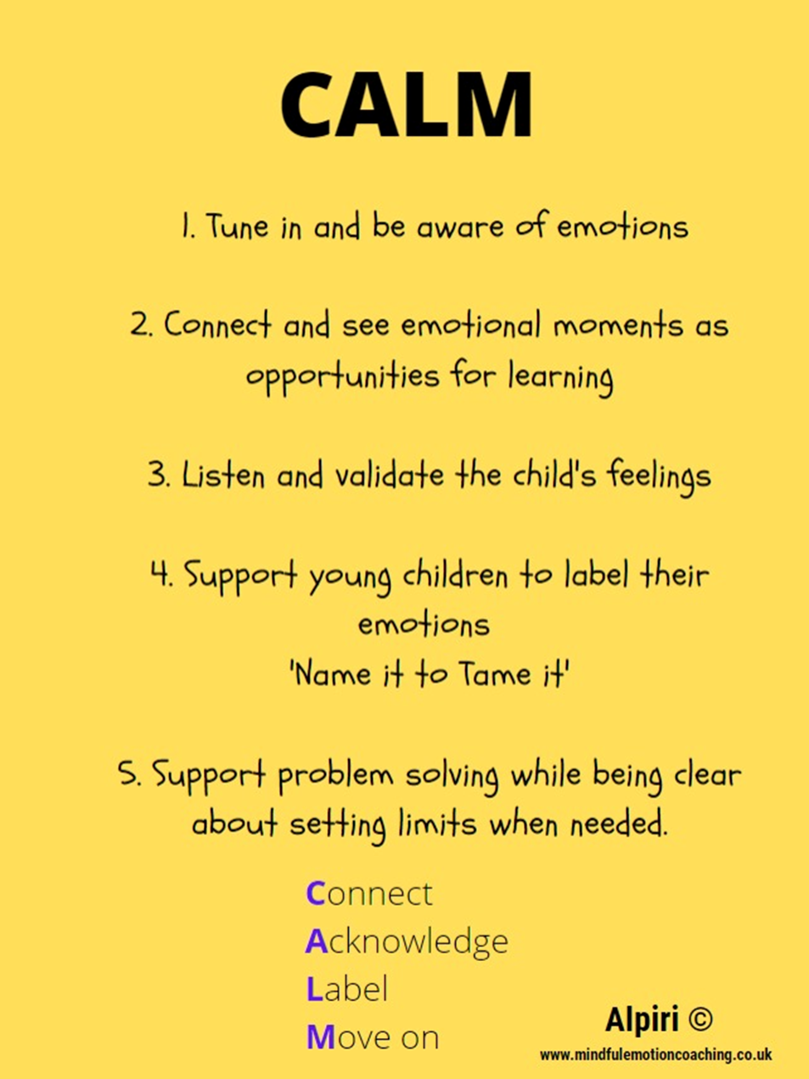
Helping your child deal with difficult emotions
Notes:
We often think we need to solve our child’s problem’s and make them happy again.
But that tends to not be the most useful way.
These steps talk through the acronym CALM as a way of helping you help your child deal with difficult feelings – it’s about connecting, acknowledging, labelling and moving on. Guiding them rather than doing for them. Helping them to learn to sit with difficult feelings.
This video clip shows this really well – what did you notice helped Bing Bong?
Sadness validates Bing Bong’s feelings, acknowledged what was hard for him. She didn’t try to distract him from his feelings or ignore them.

Slide 14
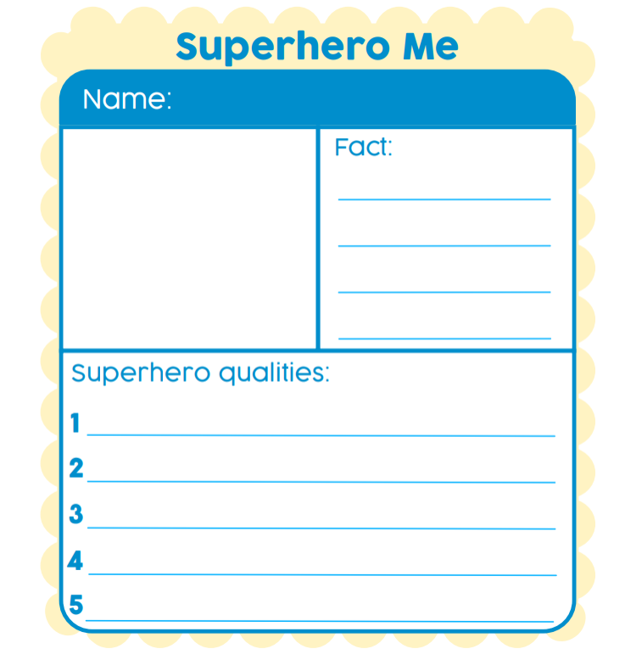
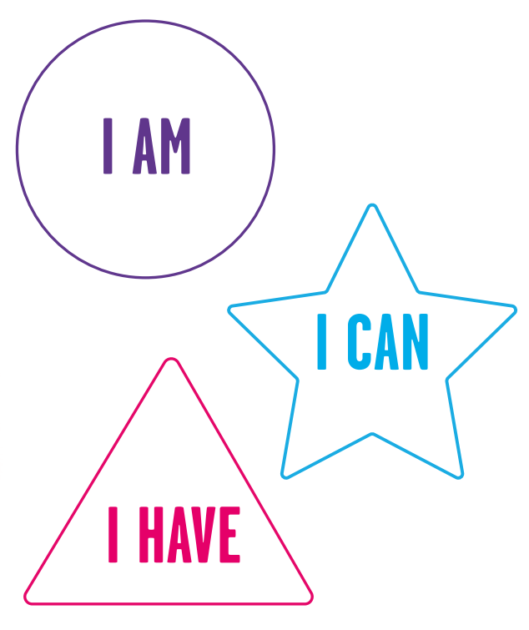
Focussing on your strengths
Anna Freud National Centre for Children and Families
Notes:
We all can fall into the trap of focussing on the negatives
Positive self talk is about trying to focus on positive thoughts/traits etc rather than only focussing on the negatives/things that aren’t going well.
Supporting children to remember their positive qualities is also really important to build self esteem
Build their strengths by giving them responsibilities and planning activities with them. Do more of what they are good at/enjoy.

Slide 15
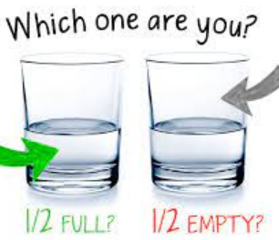
What’s going well? Three good things about today were: 1. 2. 3. What could you do to encourage more positivity with your child?
Notes:
And again, It’s easy to fall into the trap feeling that nothing is working out for us. The idea of your glass being half full or half empty fits in here.
Remembering what’s gone well today can help.
Doing something seasonal as a family can also make it more fun and kick start habits. It could be what’s gone well today or what you are grateful for.
What could you do to encourage more positivity? – chat at dinner time, focus more on positives yourself

Slide 16
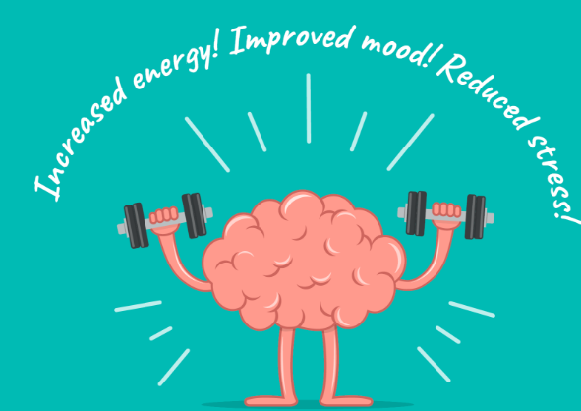
Looking after yourself physically
Notes:
Link Back to feeling positive
Good physical health and good mental health go hand in hand and often the same things that help our physical health, also help our emotional wellbeing.
For instance getting enough sleep, eating healthily and being physically healthy will help to improve our physical health as well as reducing low mood and anxiety.
Being physically active is really useful in managing anxiety or stress. Its important to try and find a physical activity that your teenager enjoys. There’s no point in forcing them to take part in an activity that they dread going to as they won’t maintain this and will more likely feel negative about future physical activity. Consider what you can do together with your child and what fun things are going on in the community as well.
Sleep is also really important for wellbeing. Things like having a good routine, winding down before bed without screen time or bright lights, making sure the room is comfortable and not being too hot/cold/hungry/full etc. are key in this. When changing the bedtime routine, it may take a while to see improvements, it’s about consistency.
Eating well is another important factor. Regular meals, remembering not to skip breakfast. Lots of fresh food, unprocessed where possible, keeping hydrated.

Slide 17
Get outdoors
Spending time outdoors is known
to be very beneficial to our
wellbeing and in managing
stress
How can you do this with your child?
18 ways to get kids to go outside – Active For Life
Notes:
Lots of ways you can do this
Trip to the park
A walk
Bike ride
Bug hunt
Many children also find it easier talk about things when they are focussed on something else
Lots of ideas online about how what you can do outside with your child/young person

Slide 18
Help your child to work towards a goal.
Is there something that your child would like to be able to do that would make a difference to their life?
Help them set a small and achievable goal
What steps do they need to take to work towards achieving the goal?
Notes:
Setting goals is a really helpful tool skill for young people to develop.
If your child is avoiding something or struggling with something in their life, supporting them to challenge themselves and work towards being able to manage this is often better than putting it off or avoiding. As we have already talked about, avoiding things that are difficult is an unhelpful coping strategy and only gets worse the longer it goes on for.
Or is there something that your child could do that would make a big difference to them? Make their life more fulfilling? Something they could achieve which would be really empowering for them or boost their self esteem.
Think with your child about what they would like to be able to go and plan some steps to help them achieve it. Key things are – small and achievable goals, break this down into small steps and consider what or who can help them with this,

Slide 19
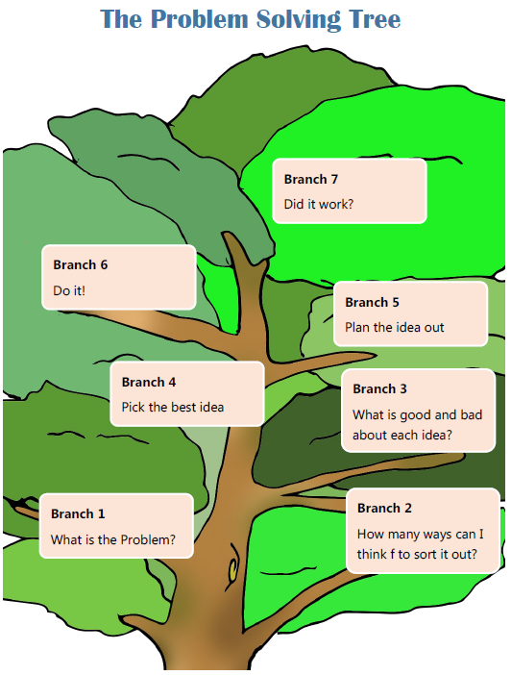
Helping your child to solve problems
Is there something in your child’s life at the moment that problem solving could help with?
Notes:
Working out how to tackle problems as they crop up can reduce our stress.
Using problem solving is a structured way of doing this.
Writing it down can be helpful to organise your ideas and options.
Being clear on the problem
Considering all potential options and their pros and cons
Deciding on the best way forward and giving it a go.
A good thing to do together! Help give ideas of potential solutions, especially for younger children. Model using it yourself.
Is there something in your child’s life you could use problem solving with them currently? E.g. exams coming us, friendship issues, wanting to join a club? Depending on the group size and engagement so far, you may wish to make this interactive.

Slide 20
Coping with change
Many of us find change difficult
There is lots of change and transitions in children and young people lives
Obviously not all change can be planned for, but the more resilience and coping skills children and young people have the better they will be at coping with it
Planning for change can help
What are the concerns?
What could be done to make it
easier?
Are there any aspects that can be controlled?
What are the positives about this change?
Who can help?
Notes:
Often the uncertainty of change is what causes us to be unsettled
Having some skills to manage and cope with change is really useful
Planning for change can be a useful way of preparing and learning to manage with change.
What might make things more certain? E.g. extra transition days, specific things like where the toilets are, general plan for the day
What they can do that might help? Problem solve ideas.
Also, thinking about times when change has gone ok in the past and perhaps has even worked for the best in the end.

Slide 21
Keep talking
Notes:
Keeping communication going between you and your child is really important so they know they have somewhere safe to go to talk about worries and stresses.
Could be chatting over breakfast or dinner
Or In the car
For younger children, regular worry time can be useful, time for the 2 of you to spend time together, play with toys whilst talking, use the Huge Bag of Worries book to work through, write worries down, model problem solving with them.
Who else can they build good relationships with – at school, in the family as sometimes having additional people to parents/carers is helpful to children.

Slide 22
Model looking after your own wellbeing
Notes:
Children and young people learn from what you say but also what they see you do.
Model recognising your emotions, taking time out, looking after your physical health and wellbeing
Problem solving difficulties that come up
Make it the norm, not the exception
Could you set yourself a goal around your own wellbeing? What could you do to prioritise and model looking after your own wellbeing? Anyone want to share?

Slide 23
Some extra tips on supporting resilience in your child
Be a good role model
Be mindful of the impact of the internet use and social media on your child’s wellbeing
Work on building positive social networks and relationships
Support your child with trying something new
Encourage roles, responsibilities and challenges to build confidence and self esteem
Have a good routine
Plan things to look forward to that you’ll enjoy together
Try not to dwell on the past, learn from experience and move on
Ask for help when you need it
Have a regular check in with your child
Notes:
If you feel you need support with any of this, school will be able to signpost you.
There is guidance available on internet safety that schools generally have available if that is a concern for you.

Slide 24
Who else can help?
School
The CAMHS WEST Team www.camhs.hacw.nhs.uk/west
GP
Starting Well Partnership (Worcestershire) https://www.startingwellworcs.nhs.uk/ offer a range of support and will have lots of information about services available
Early Help in Worcestershire https://www.talkcommunitydirectory.org/children-and-families
www.youngminds.org.uk information and tips for parents and young people
Notes:
School has a mental health lead and various pastoral staff who can support you and your child if you have concerns
In WEST we offer a range of support in your school. There is more information on our website and again school could discuss with you whether a referral to us would be useful. Our website also contacts lots of online resources and information.
GP can be useful if you have concerns for physical health that may be impacting.

Slide 25
Thank you and Good luck
We hope this has been interesting and useful.
If you feel your child would benefit from a referral to our WEST team to support them with their mental wellbeing, please speak to your child and school
Notes:
Please ask the group to complete the evaluation form, it’s just 3 questions. This helps us to evaluate the service we provide and hopefully demonstrate it’s effectiveness.
If any parents feel their child would benefit from support from WEST to help them address their menta wellbeing, they can speak to school ataff about whether a referral to us would be useful. Schools don’t always recognise things if a yp is functioning ok at school so they may need you to share with them any concerns..
Direct to our website to watch these presentations again if they wish!

